Slide 1
Chronic Stress and Immune Function
Georgia Tetlow, MD, ABOIM, IFMCP
Dr. Tetlow’s content development sponsored by Integrative Therapeutics
Notes:
**DISCLAIMER ADDED THIS IS SPONSORED BY INTEGRATIVE THERAPEUTICS**

Slide 2
Stress in US Population
30%
45%
72%
45%
19%
respondents
people
respondents
people
people
saw a doctor about stress in the past year.¹
with a mental health condition said stress worsened their symptoms.¹
stated their lives have been disrupted since late March 2020.²
stated their worry and stress is having a negative impact on their mental health.²
stated their worry and stress is having a MAJOR negative impact on their mental health.²
Notes:
According to the American Psychological Association
American Psychological Association’s 2019 Stress in America survey
Kaiser Family Foundation

Slide 3
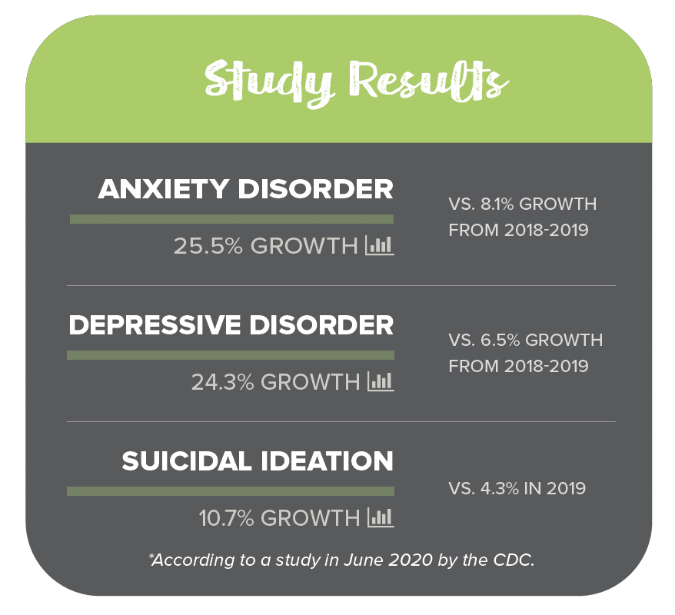
Stress in US Population

Slide 4
Chronic Stress and Immunity
Major effects including:
The continuous increase in stress hormones can also result in suppression of the immune system’s white blood cells, leading to an increased risk of infections.³
Long–term immune changes are one of the possible pathways through which chronic stress enhances the vulnerability to infectious, neoplastic, and autoimmune disease. ^{4,5}
The risk for common cold is proportional to the degree of stress in a person’s life.^{6,7}
Notes:
Sources:
3. Cohen S, Janicki-Deverts D, Doyle WJ, et al. Chronic stress, glucocorticoid receptor resistance, inflammation, and disease risk. Proc Natl Acad Sci U S A. 2012;109(16):5995–5999. doi:10.1073/pnas.1118355109
4. Whiteside TL, Herberman RB. Role of human NK cells in health and disease. Clin Diagn Lab Immunol. 1994;1:125–133.
5. Dragoş D, Tănăsescu MD. The effect of stress on the defense systems. J Med Life. 2010;3(1):10-18.
6. Cohen S, et al. Psychological stress and susceptibility to the common cold. New England Journal of Medicine. 1991; 325:606. doi:10.1056/NEJM199108293250903
7. Cohen S, Frank E, Doyle WJ, Skoner DP, Rabin BS, Gwaltney JM Jr. Types of stressors that increase susceptibility to the common cold in healthy adults. Health Psychol. 1998;17(3):214-23. doi:10.1037//0278-6133.17.3.214

Slide 5
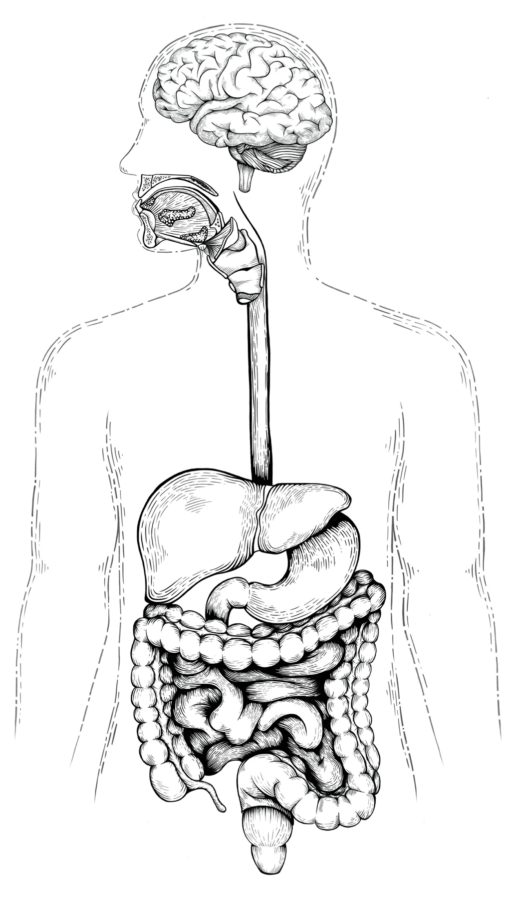
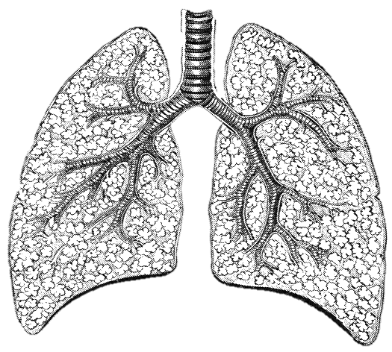
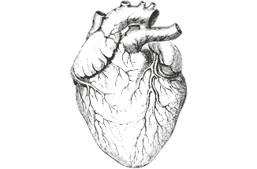
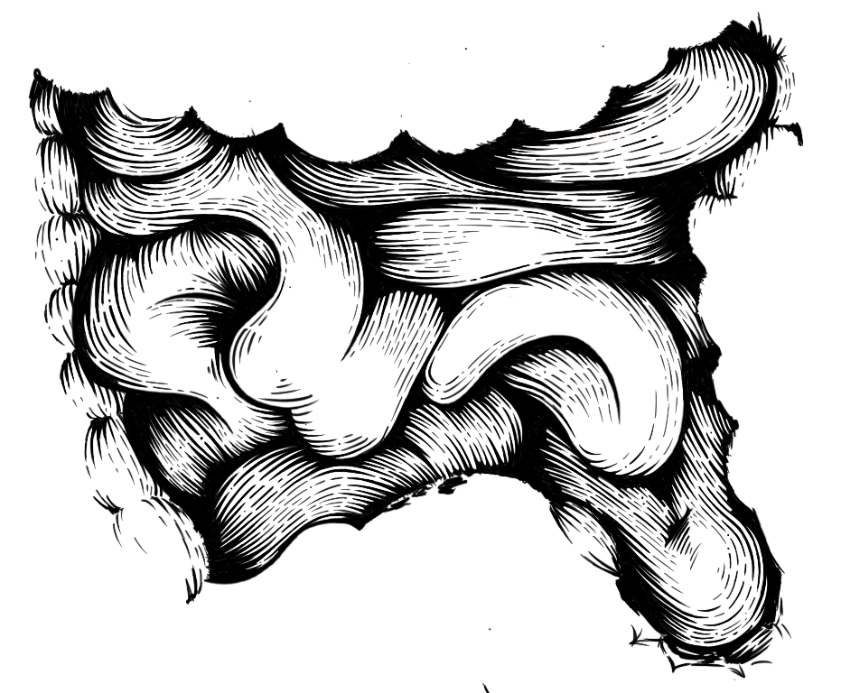
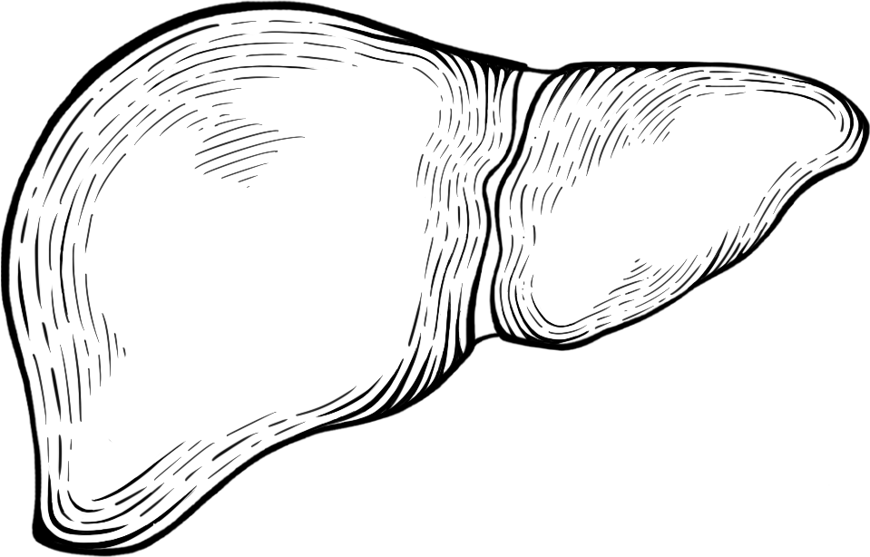
What happens to the body under stress
corticotrophin–releasing hormone (CRH) ⁸
enhancing the release of corticosteroids ⁸
Catecholamines ⁸
Opiates ⁸
growth hormone ⁸
Prolactin ⁸
sleep deprivation ^{9, 10, 11}
IL-1 and IL-6 ¹²
NK cell responsiveness to cytokines ¹³
NK cell ability to kill target cells ¹⁴
T lymphocytes ¹⁵
*Sources: CDC.gov & additional citations (see below)
**Immune Axes (17 citations below)
Notes:
Sources:
8. Dragoş D, Tănăsescu MD. The effect of stress on the defense systems. J Med Life. 2010;3(1):10-18.
9. Spiegel K, Sheridan JF, Van Cauter E. Effect of sleep deprivation on response to immunization. JAMA. 2002;288:1471–1472.
10. Irwin MR, Mascovich A, Gillin JC, Willoughby R, Pike J. Partial sleep deprivation reduces NK cell activity in humans. Psychosom Med. 1994;56:493–498.
11. Irwin MR. Effects of sleep and sleep loss on immunity and cytokines. Brain Behav Immun. 2002;16:503–512.
12. Chancellor-Freeland C, Zhu GF, Kage R, Beller DI, Leeman SE, Black PH. Ann N Y Acad Sci. 1995 Dec 29; 771():472-84.
13. Esterling BA, Kiecolt–Glaser JK, Glaser R. Psychosocial modulation of cytokine–induced NK cell activity in older adults. Psychosom Med. 1996;58:264–272.
14. Segerstrom SC, Miller GE. Psychological stress and the human immune system: a meta-analytic study of 30 years of inquiry. Psychol Bull. 2004 Jul; 130(4):601-30.
15. Mills PJ, Yu H, Patterson T, Grant I. Vulnerable caregivers of patients with Alzheimer’s disease have a deficit in circulating CD62L– T lymphocytes. Psychosom Med. 1999;61:168–174.

Slide 6
Dr. Tetlow’s Tips for Stress Management
https://fullscript.com/blog/stress-affecting-the-body
https://fullscript.com/blog/lifestyle-tips-and-supplements-for-immune-health

Slide 7
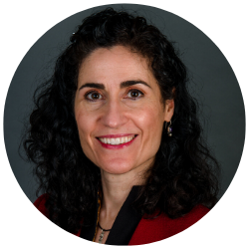
Georgia Tetlow, MD, ABOIM, IFMCP
Dr. Tetlow founded Philadelphia Integrative Medicine (PIM) in 2009, a model site for integrative and functional medicine application and onsite clinician mentoring. PIM’s vision is to empower, inspire change and create trust with patients, PIM providers and staff, the functional medicine community and ultimately the medical community at large. Dr. Tetlow maintains a thriving patient care practice and mentoring practice for clinicians in transition or maintenance phases of integrative and functional medicine practice. She began mentoring health care providers in 2002 and has pioneered a self care curriculum entitled Honor Self. In addition, she is a Clinical Assistant Professor of Rehabilitation Medicine, Sidney Kimmel College, Thomas Jefferson University in Philadelphia, PA.
Learn more about Philadelphia Integrative Medicine at: https://philly-im.com/providers

